Slide 1
Env DS Project 2
Data-Driven Climate Forecasting
An Exploratory and Predictive Analysis of Temperature from 2000 to 2080
Presented By Zhihao Xu - Esteban Guerrero Rebecca Jones - Chenyu Ma
Notes:
Hi everyone.This is our project: Data-Driven Climate Forecasting, an exploratory and predictive analysis of temp from 2000-2080.

Slide 2
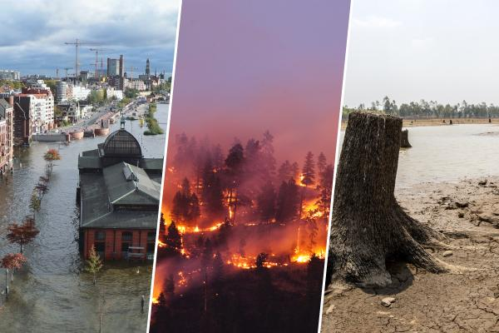
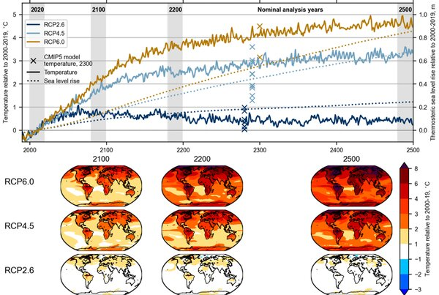
Climate Projections: Why Do They Matter?
Notes:
As global climate change intensifies, we’re experiencing more frequent and severe extreme weather events—like the floods, wildfires, and droughts. As data scientists, we know that accurate predictions can help us reduce the damage caused by these events. Different climate variables—temperature, precipitation, wind, and snowfall—change in various ways under different scenarios, highlighting the uncertainties of our future climate. By examining these trends, we can better understand what to expect and prepare accordingly. To achieve this, we compare both machine learning and traditional statistical models, as their performance and reliability can vary, making a thorough comparison essential. With this context in mind, let’s look at the specific questions guiding our study:
Climate projections are essential for predicting future climate conditions based on different greenhouse gas scenarios, allowing us to take early action against the consequences of climate change. Climate variables—such as temperature, precipitation, wind, and snow—evolve differently across various projections, reflecting the uncertainties and complexities of future climate patterns. Analyzing these variations helps identify trends and improve our understanding of potential climate shifts. To make accurate predictions, both machine learning and traditional statistical models are widely used, yet their performance and reliability can vary, highlighting the need for comparative analysis.

Slide 3

Research Questions
How do different climate variables behave across various climate projections?
Which variables exhibit the greatest changes between the early and future decades?
How do machine learning and statistical models compare in predicting temperature time series from climate projections?

Slide 4
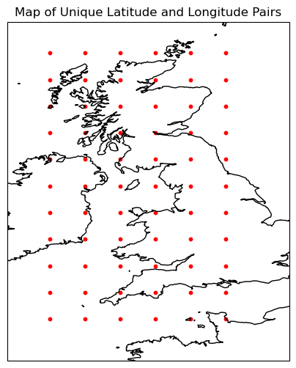
Original Datasets
6 datasets in the form of .nc files containing:
11 Unique latitudes
6 Unique longitudes
27,374 Time stamps/dataset
Latitude range: 49.47644 to 58.900524
Longitude range: 352.5 to 358.75
Time period: 2006-01-02 to 2080-12-31
Notes:
We utilised 6 NETCDF datasets in this project covering the region of the United Kingdom. With each dataset containing 11 unique latitude points, 6 unique longitude points, and 27,374 time stamps. Geographic coverage spans from 49.47° to 58.90° North with a Longitudinal range from 352.5° to 358.75° East. This data covers a comprehensive time period from 2006 to 2080 (74 years of data, 55 of which are projected).

Slide 5
Data Manipulation and Transformations
Latitude converted from 0-360 to -180-180 range
More commonly used in mapping
Centered on the prime meridian
Aligns with cartopy
Converted temperature from Kelvin (K) to Celcius (°C)
Celsius is easier for general audiences to understand
Created decade coordinates
Created a new coordinate that groups years into decades
Helpful for aggregating data, visualising long-term trends, & simplifying time-based analysis
E.g. 2023 becomes 2020
Notes:
We made three key preprocessing transformations:
Converted longitude from 0-360 to -180-180 range because it Improves mapping compatibility, Centers data on Prime Meridian and Aligns with Cartopy mapping library
Converted temperature from Kelvin to Celsius because celsius is easier for general audiences to understand
Created decade coordinates to group years into decades since this data spans for such a long length of time, it is helpful for viusalising and simplifying long-term trends analysis.

Slide 6
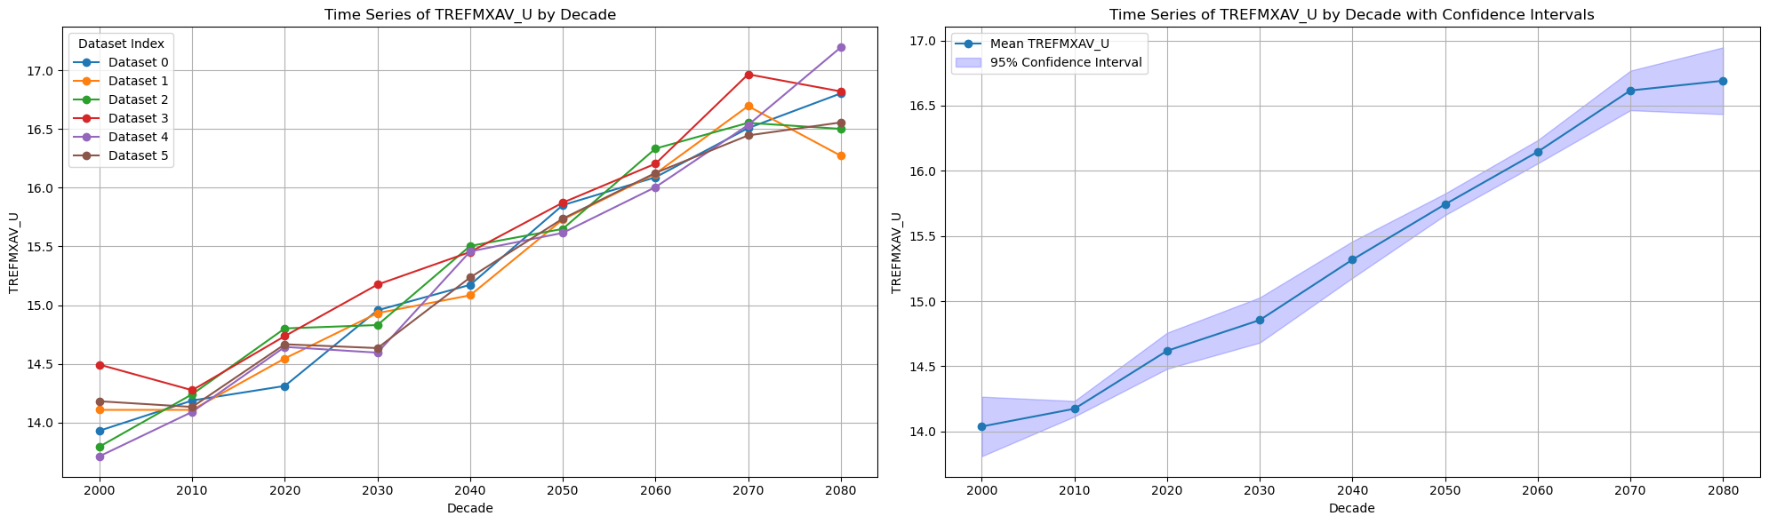
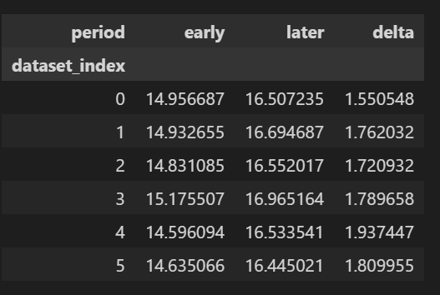
Time series of all variables were generated. All datasets agree with the overall positive correlation in TREFMXAV_U.
Notes:
Time series of all variables were generated. All datasets agree with the overall positive correlation in TREFMXAV_U as we can see here with the graphs as well as the table comparing an early period of data to a later period. The difference is shown with delta.

Slide 7
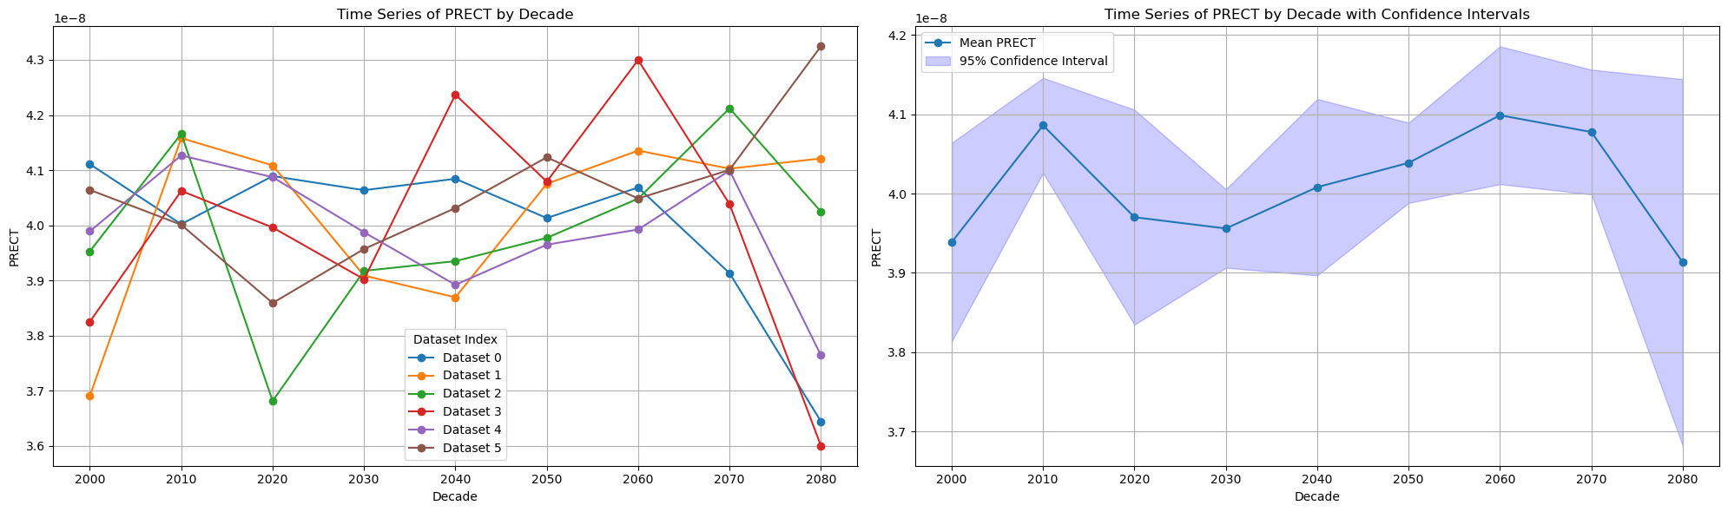
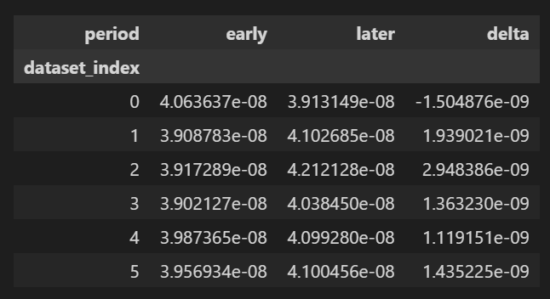
Notably, some variables predict different trends and outcomes for other variables, for example PRECT.
Notes:
Finally, it is worth noting that some variables predict different trends and outcomes for other variables, for example PRECT or precipitation rates differ for models, with some suggesting it will overall increase and others saying there is an overall decrease.

Slide 8
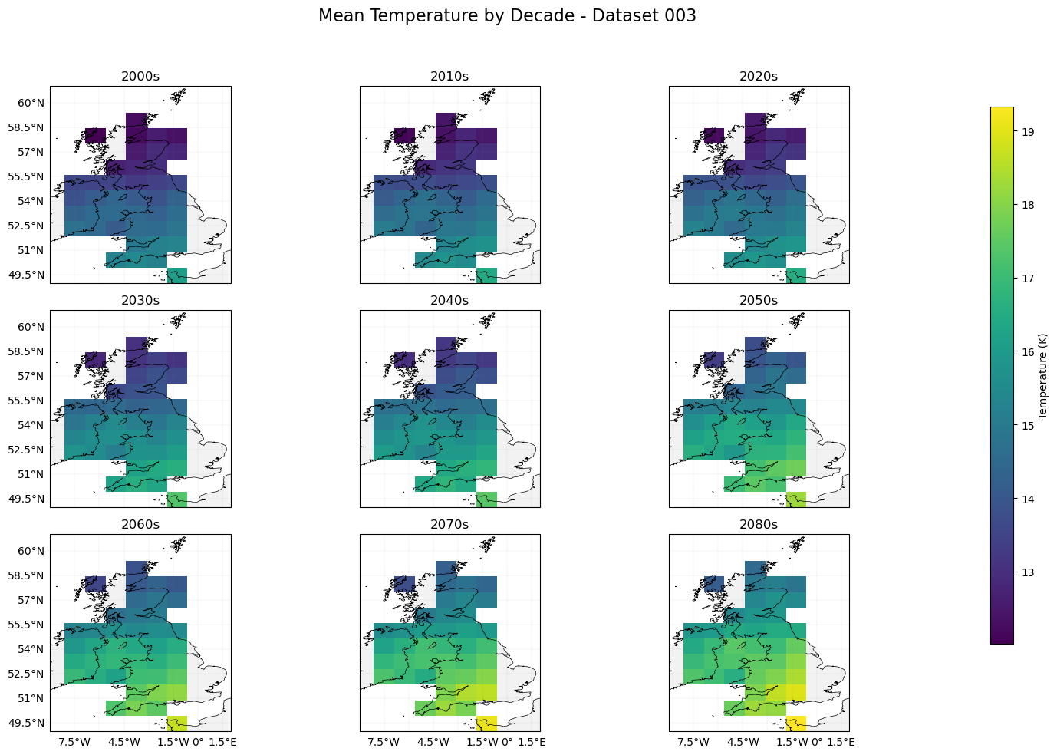
EDA
Examination of TREFMXAV_U by decade using dataset 003.
Warming trend can be seen here, with lighter colours representing higher temperatures.
Notes:
We started some EDA by examining daily Maximum temperature using 1 of the 6 datasets. A warming trend can be seen here, with lighter colours representing the higher temperatures.

Slide 9
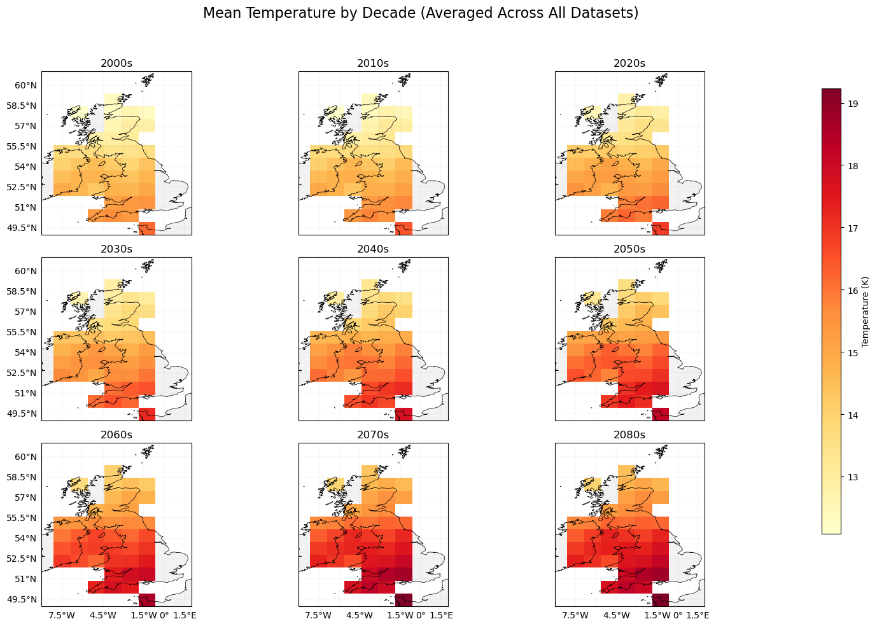
Examination of TREFMXAV_U by decade averaged across all datasets.
Warming trend is also seen when using the mean of all datasets.
The average % change of TREFMXAV_U across all datasets is +11.87%
Notes:
We then examined daily maximum temperature averaged across all datasets and a warming trends can be seen here too. We found the average percentage increase change of maximum temperature is 11.87% across all datasets.

Slide 10
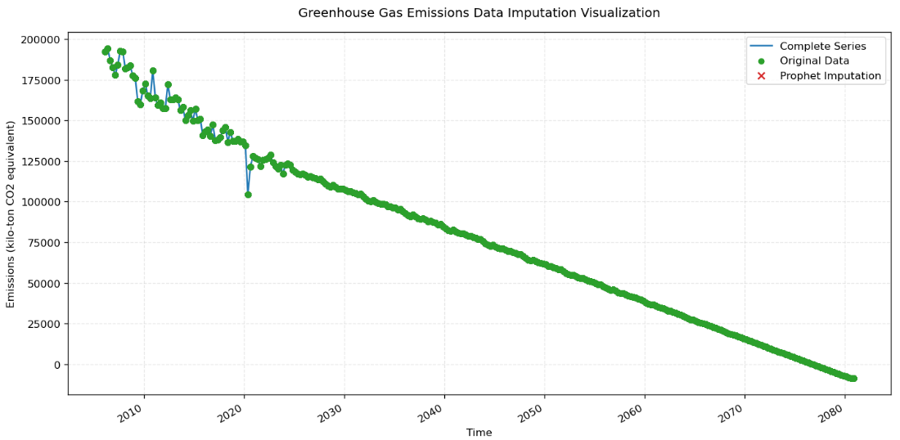
Handling GHG Emissions Data Gap
Prophet Time Series Forecasting：
Configure annual + quarterly seasonality
Generate prediction based on historical trends
Notes:
When preparing the LSTM prediction modeling, we identified a gap in the GHG emissions dataset ending at 2024Q3. To ensure complete temporal coverage for model input, we used Prophet for forecasting. By converting historical data into a time series with explicit quarterly markers, Prophet automatically captures annual cyclical patterns.

Slide 11
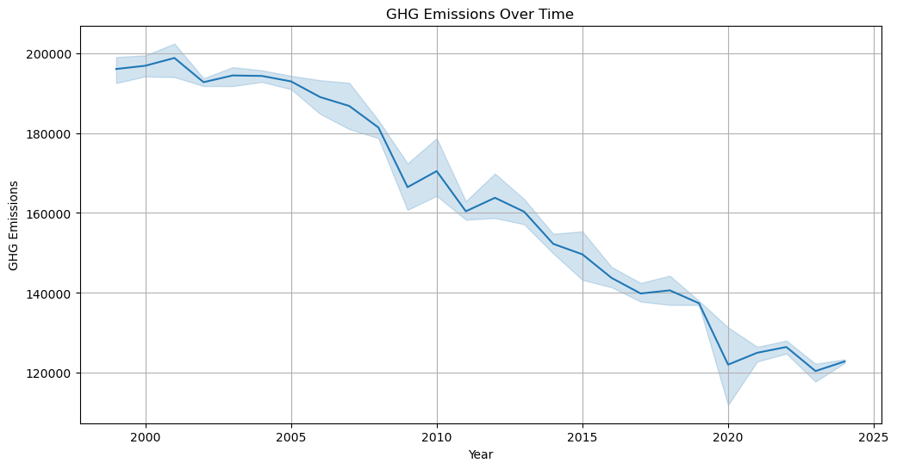
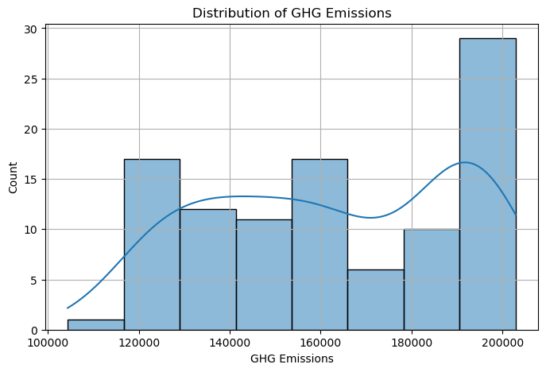
GHG Datasets

Slide 12
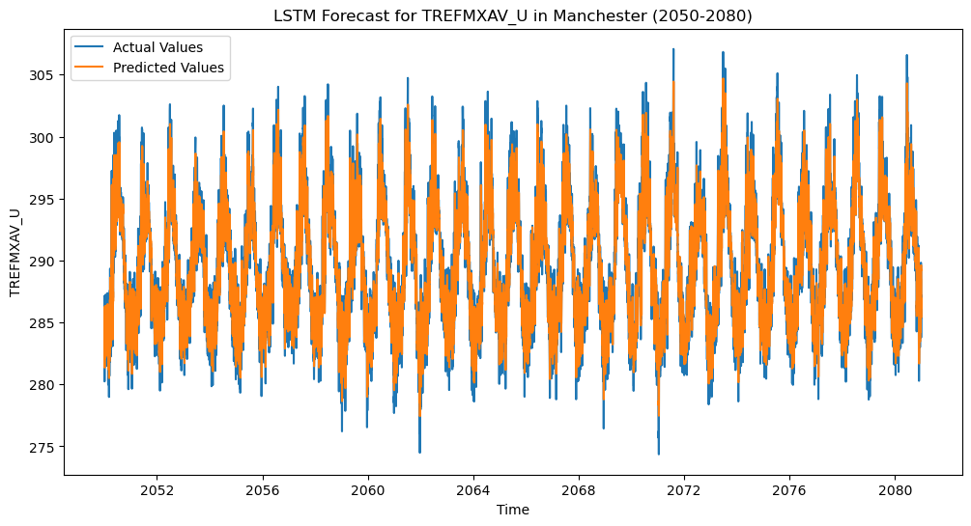
Model Performance - LSTM Forecast with 6 datasets
Evaluation Metrics:
(dataset 1)
MAE: 1.554
MSE: 3.959
RMSE: 1.990
R2 Score: 0.853
MAPE: 0.54%
Notes:
We implemented a simple LSTM model for prediction. LSTMs were chosen for their ability to learn long-term dependencies in time-series data. The model uses a single LSTM layer (50 units) and a linear output layer, optimized with Adam to minimize prediction errors. Our baseline LSTM model achieves strong performance in temperature prediction. The extremely low error rates indicate high precision in tracking both long-term trends and short-term fluctuations.

Slide 13
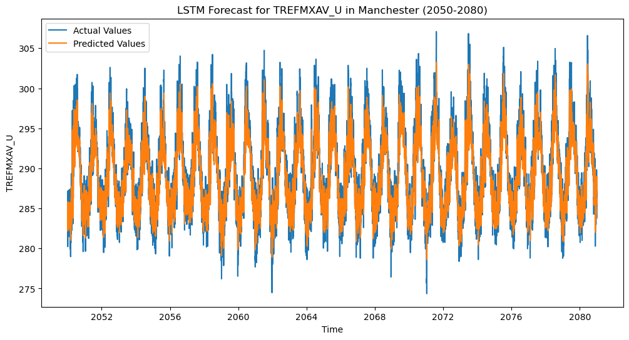
Complex Model
Evaluation Metrics:
(dataset 1)
MAE: 1.695 ↑
MSE: 4.620 ↑
RMSE: 2.150 ↑
R2 Score: 0.828 ↓
MAPE: 0.58% ↑
Notes:
Our enhanced LSTM architecture with stacked layers and dropout regularization showed reduced predictive accuracy compared to the simpler baseline. This suggests the added complexity may be capturing noise rather than true climate signals.

Slide 14
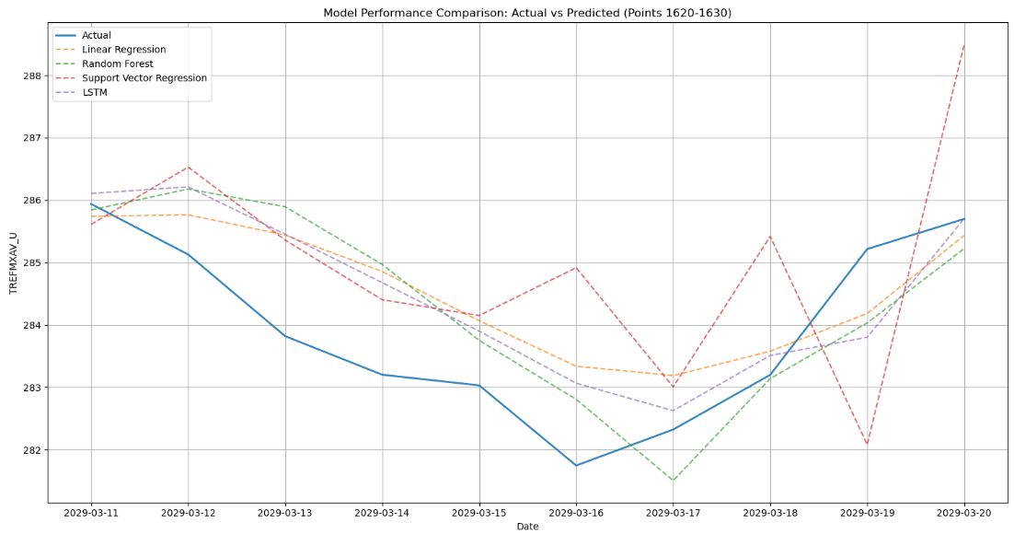
Model Performance Comparison
Table. Model Performance Comparison
 | MAE | RMSE | R^2
Linear Regression | 1.510 | 1.940 | 0.870
Random Forest | 1.513 | 1.973 | 0.865
Support Vector Regression | 6.511 | 8.218 | -1.341
LSTM | 1.604 | 2.032 | 0.857
Notes:
"We therefore implemented a simple LSTM model and created multiple supervised models for comparative analysis. Our model comparison reveals critical insights： While the LSTM achieved competitive accuracy, it requires significantly more computational resources and training time compared to linear methods. More critically, its sequential processing architecture shows diminishing returns on our dataset.
However, we retain LSTM as our core model because its temporal awareness enables multi-step climate projections that traditional models cannot generate.

Slide 15
Conclusion
Key Insights from EDA
• Identified temperature variables (e.g., TREFMXAV_U) as primary indicators showing a consistent warming trend.
• Noted higher variability in precipitation-related variables (e.g., PRECT), suggesting greater uncertainty.
Model Performance Comparison
• Simpler models demonstrated better interpretability and reduced overfitting, highlighting the importance of model complexity vs. data size.
• Statistical models outperformed more complex machine learning approaches under current conditions.
Notes:
In this section, we summarize two points in our project:
• Key Insights from EDA: We found that temperature variables (like TREFMXAV_U) show a clear warming trend, while precipitation variables (e.g., PRECT) are more uncertain.
• Model Performance Comparison: Simpler models were easier to interpret and avoided overfitting. Under our conditions, statistical models also outperformed more complex machine learning approaches.

Slide 16
Future work
• Incorporate More Climate Variables
Consider adding additional factors (e.g., ocean temperatures, wind speeds) to enhance prediction accuracy.
• Model Integration and Comparison
Experiment with various approaches (e.g., ensemble models, hybrid methods) to balance prediction performance with interpretability.
• Improve Data Quality and Updates
Continuously collect and update the latest climate observations and emissions data to refine time series and reduce biases from missing data.
Notes:
Future Work, we have three directions:
• Incorporate More Climate Variables: We plan to add factors like ocean temperature and wind speed to improve predictions.
• Model Integration and Comparison: We’ll explore methods like ensemble or hybrid models for better balance between performance and interpretability.
• Improve Data Quality and Updates: We’ll keep gathering the latest climate and emissions data to refine our time series and minimize gaps.

Slide 17
Thank you for your listening!

